Slide 1

CISP 1020 Retail Project Spring 2023
Paul Ferris, Thomas McCarthy, Seska Linn, Wesley Freeman, Joshua Garcia, Joseph Collins

Slide 2
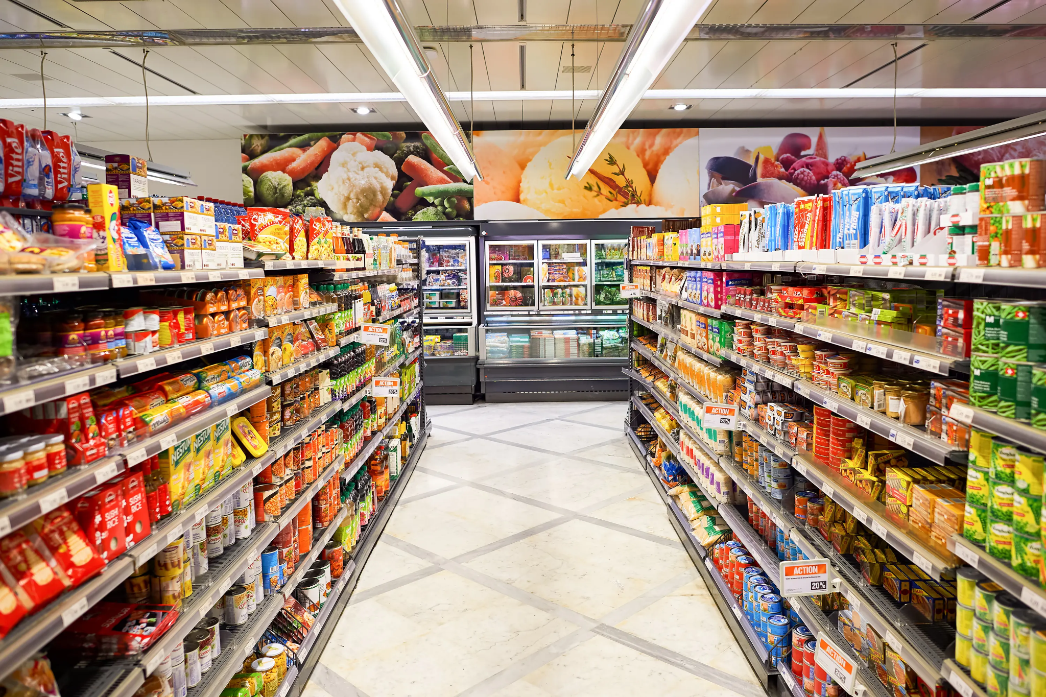
Scenario
Giant Grocery Store is planning to implement a retail operation system to manage the store, keep track
of the customers, shopping pattern, their loyalty, and the offers. The store that decided to make
different offers on some products as follows:
o Every shampoo - buy one get one free
o Canned vegetable $3.50 each (buy 3 for $10)
o 50% off for every 4 cereal boxes
o Loyalty points is also implemented so that the customers can gain points every time they
purchase to be used for money off in the future purchases.

Slide 3
Tasks
o Add, modify and delete customers, and items details.
o Search feature for finding customers.
o The payment system/feature allows to calculate payment details and print bills.
o The program should be able to identify the offers for the items in any order.
o Loyalty card has the customer information and keep track of the collected points.
o For the points: every 20 dollars is 5 points and when the customer reaches 500 points
he/she will get a discount of 10 dollars.

Slide 4
Classes
Bill
Grocery
LoyaltyCard
Retail

Slide 5
Bill Class

Slide 6

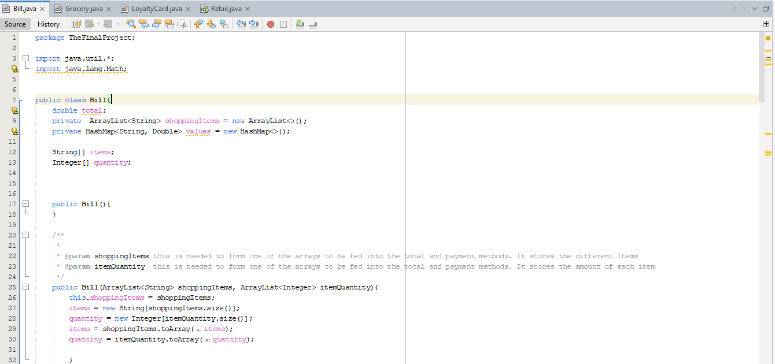

Slide 7
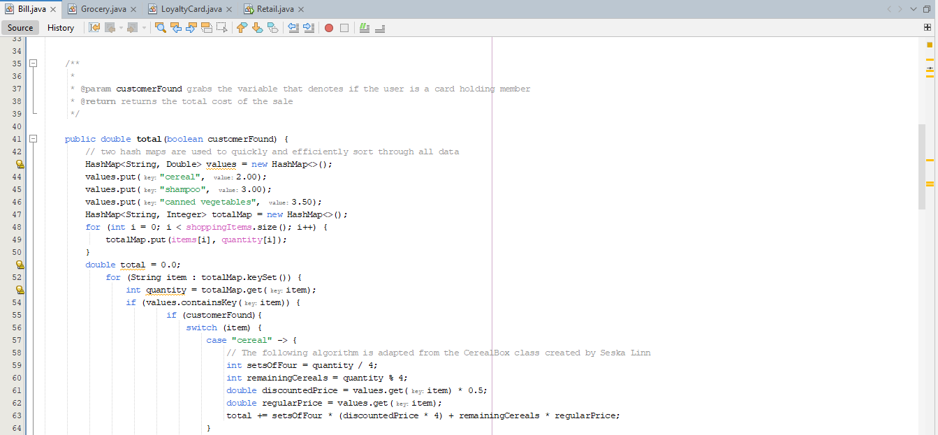

Slide 8
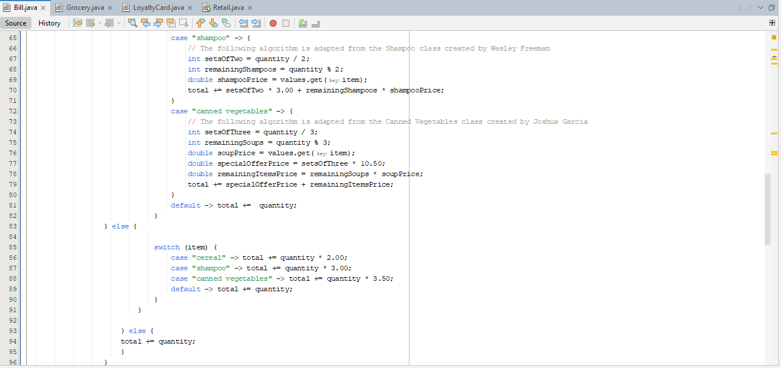

Slide 9
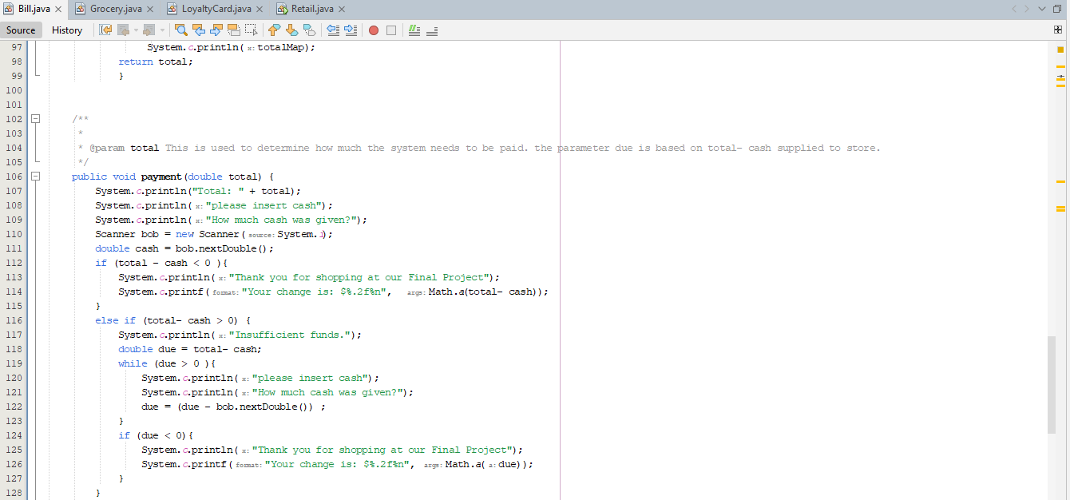

Slide 10
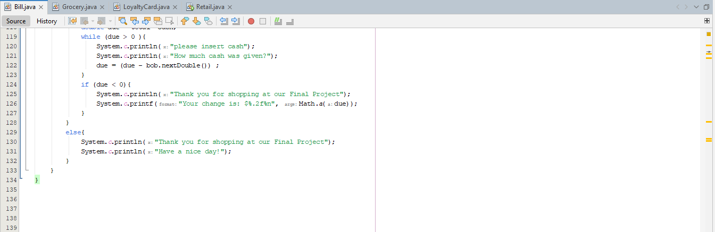

Slide 11
Grocery Class

Slide 12
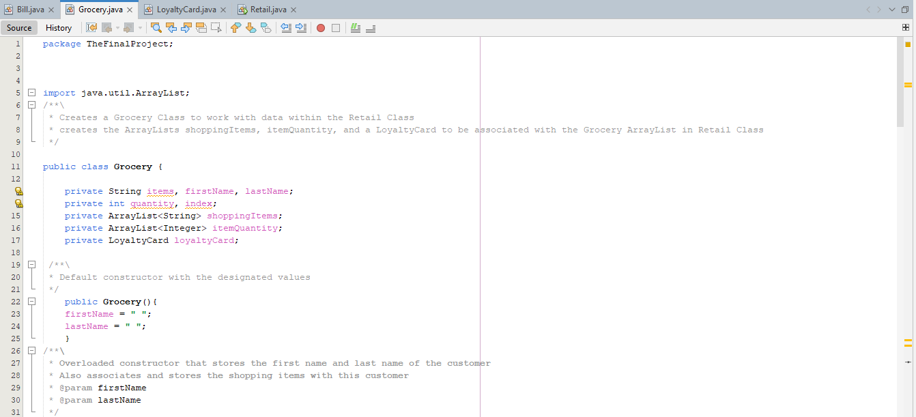

Slide 13
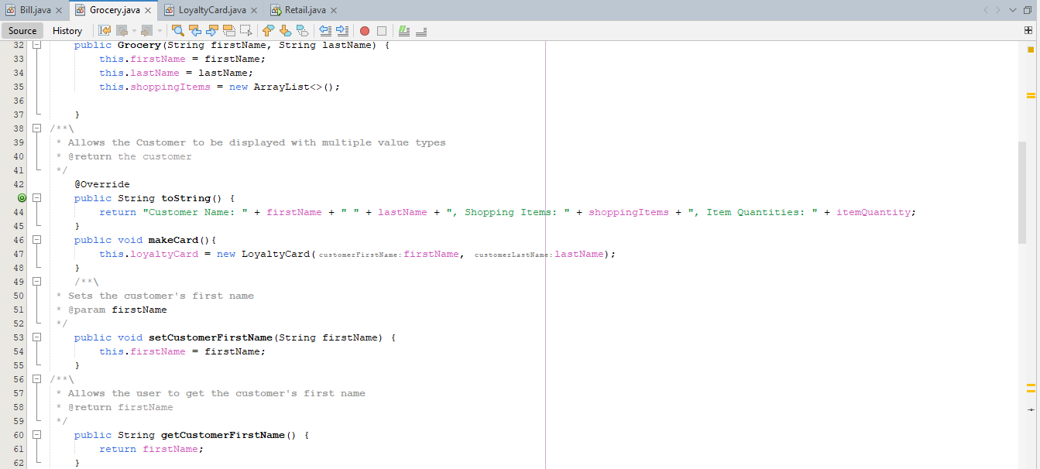

Slide 14
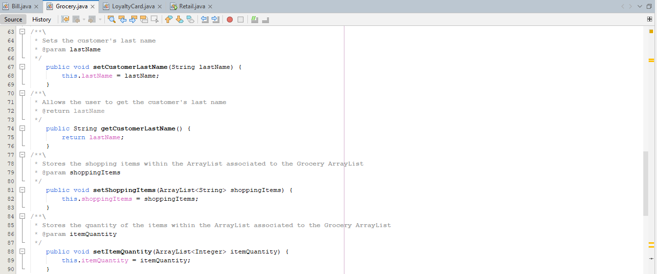

Slide 15
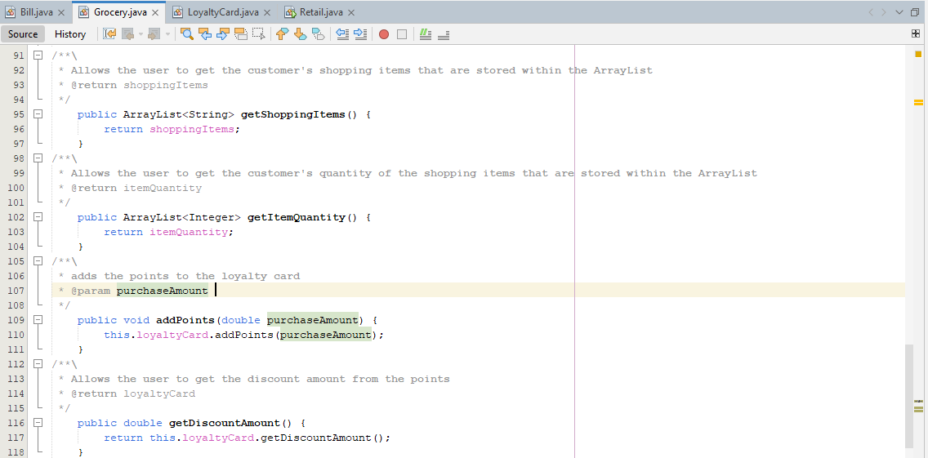

Slide 16
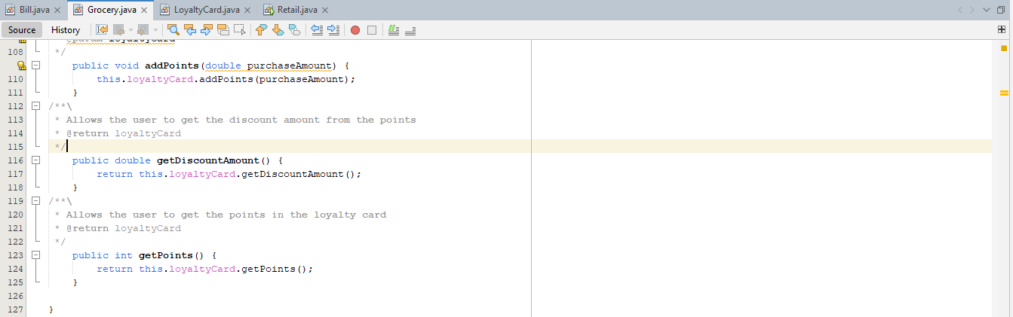

Slide 17
LoyaltyCard Class

Slide 18
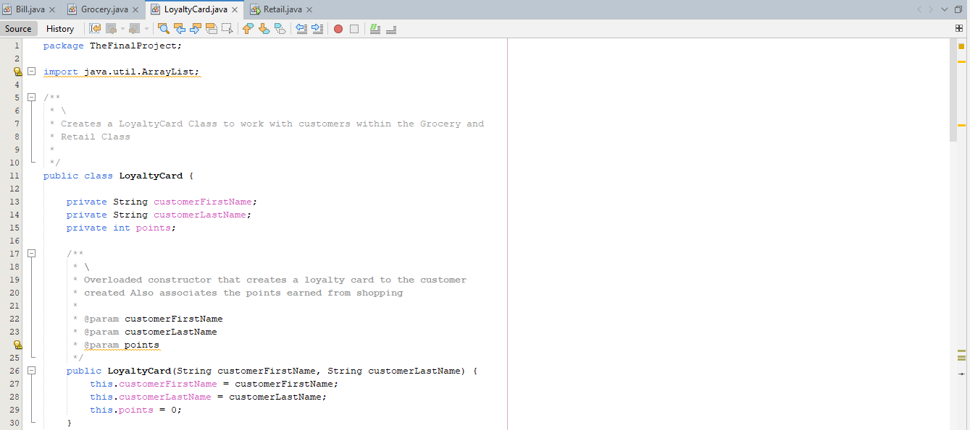

Slide 19
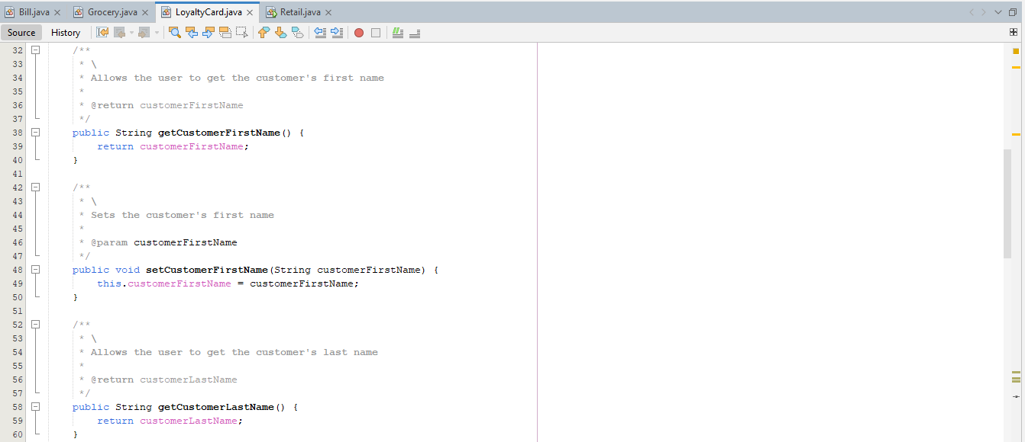

Slide 20
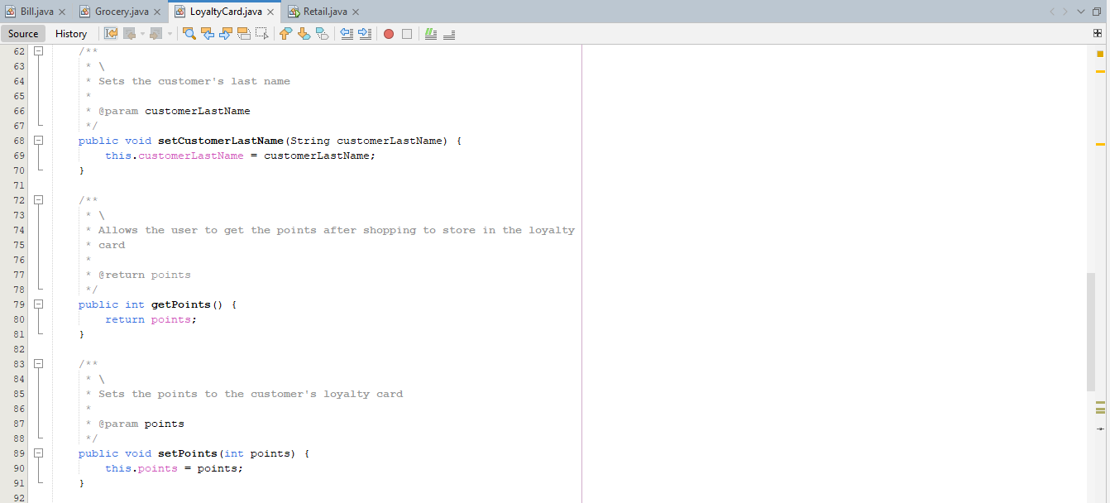

Slide 21
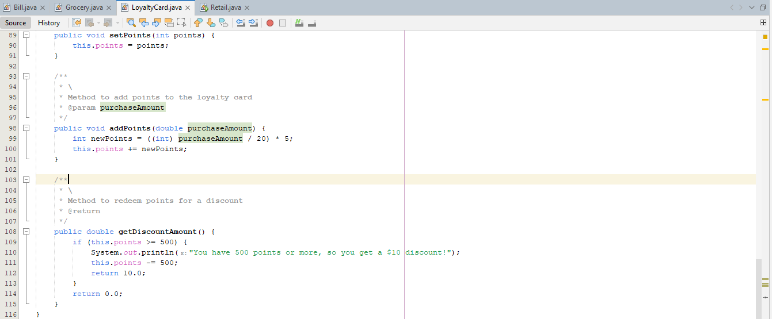

Slide 22
Retail Class

Slide 23
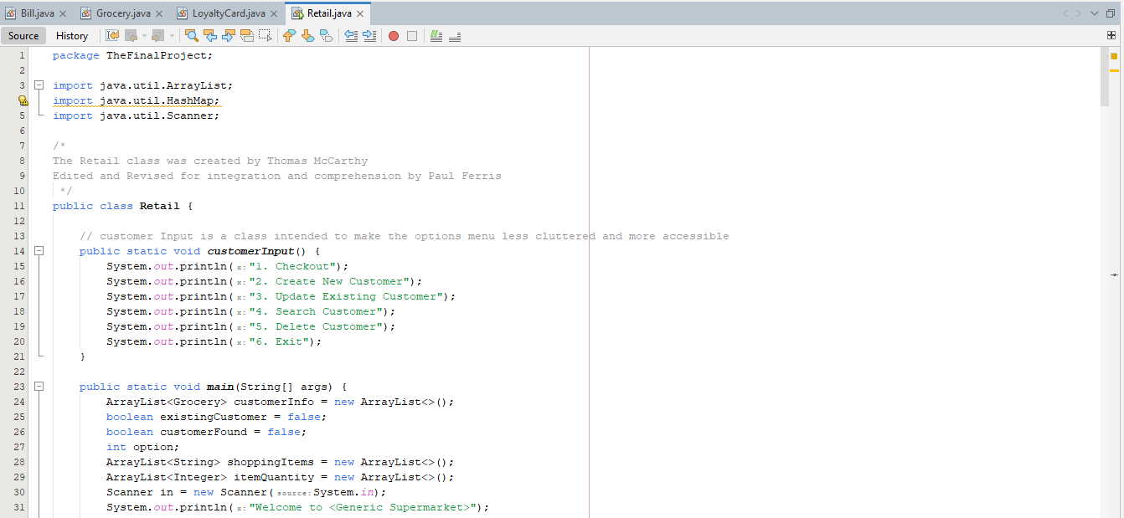

Slide 24
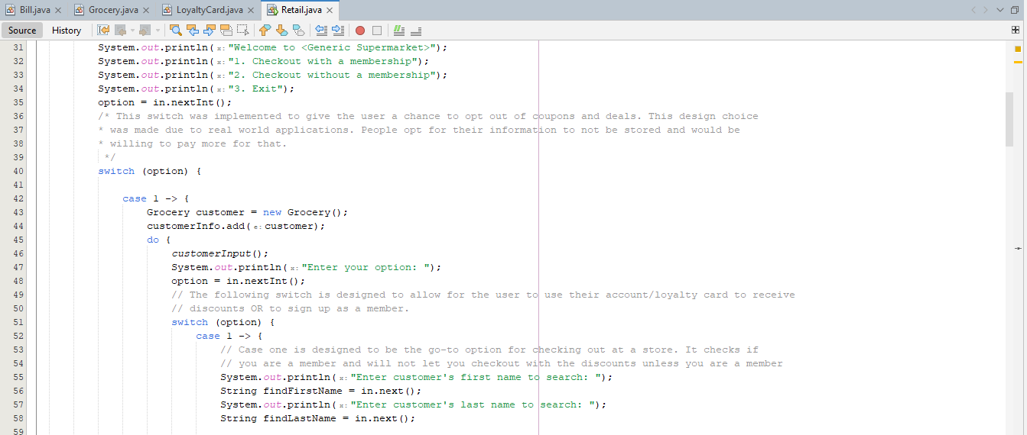

Slide 25
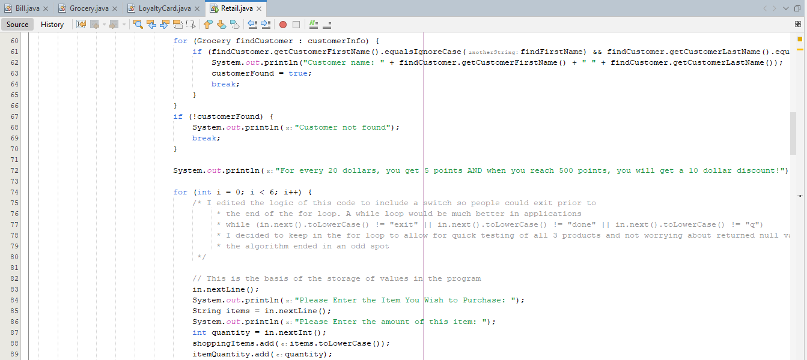

Slide 26
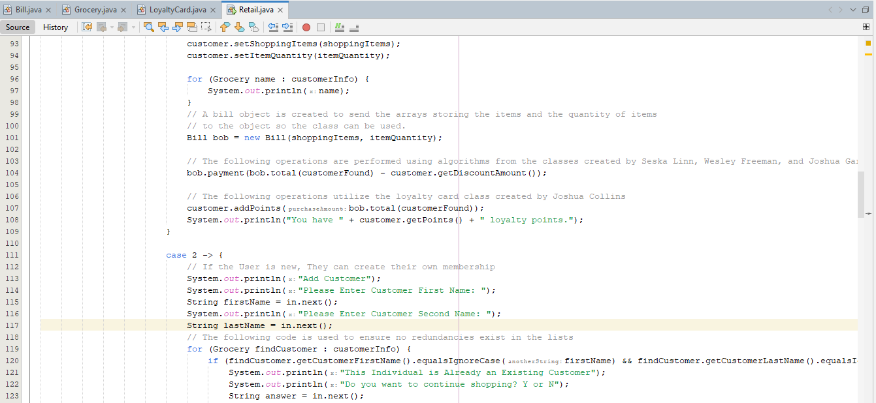

Slide 27
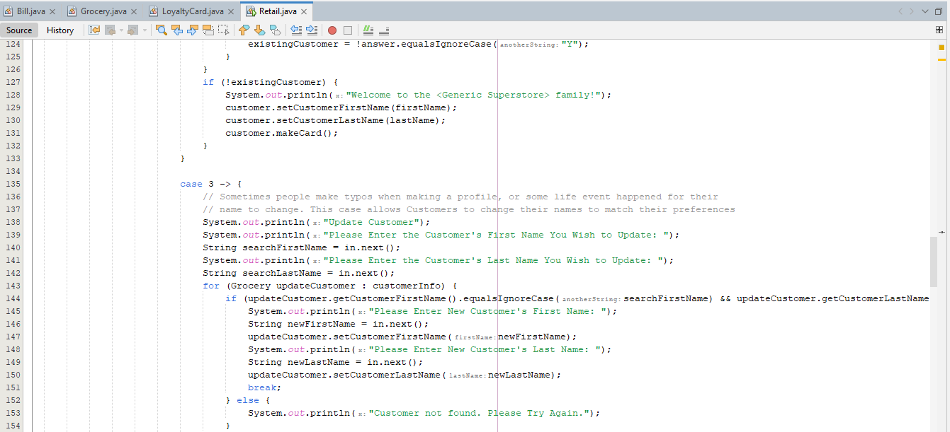
Notes:
This specific part is checking whether a customer already exists in the system or not. This part allows you to enter in the customer name.
It starts with an "if" statement that checks the value of "existingCustomer". If it is false, meaning the customer doesn’t exist in the system, the program will print a welcome message and create a new customer card. If it's true, the program will skip this part and move on to the next case.
Then case 3 allows customers to update their profile information, such as their first and last names.
The program first asks the user to enter the first and last names of the customer they want to update where it loops through the list of customer information and checks if there is a match. If there is, the program will prompt the user to enter the new first and last names, update the customer's information. With no match, the program will print an error message and ask the user to try again.

Slide 28
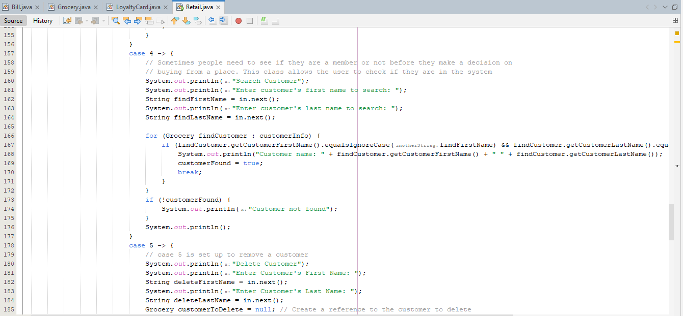
Notes:
This case allows the user to check if they are in the system. The program first prompts the user to enter the first and last names of the customer they want to find where it then loops through the list of customer information and checks if there is a match. If there isn’t a match, the program will skip the "if" statement and print that the customer was not found. If there is a match, the program will print the customer's name and set the boolean value of "customerFound" to true.
The next part of the code which is case 5 is a setup to remove a customer. It asks to enter the first and last names of the customer they want to delete which begins the loop through the list of customer information and checks if there is a match with the entered first and last names.

Slide 29
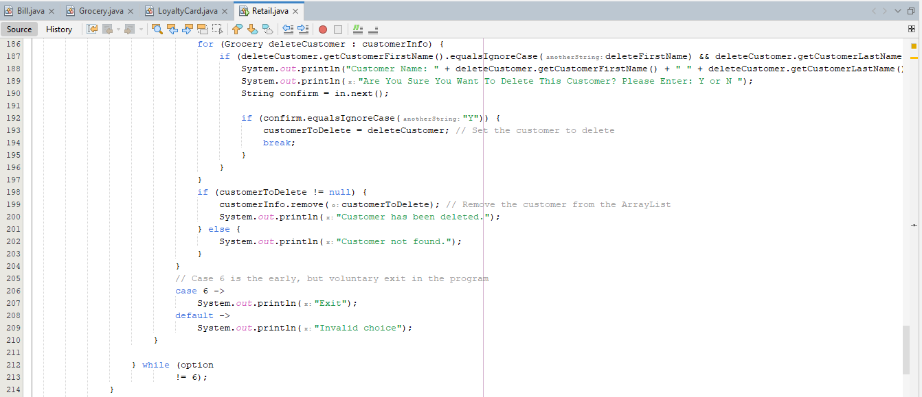
Notes:
If there is a match, the program will print the customer's name and prompt if they would like to proceed with the process, which is where they would confirm “Y” for yes, where the program will set the reference of "customerToDelete" and break out of the loop. If the user enters “N” to not confirm, the loop will continue until a match is found.
Now case 6 is just meant to handle the situation where the user wants to exit the program where it just simply prints “Exit.”

Slide 30
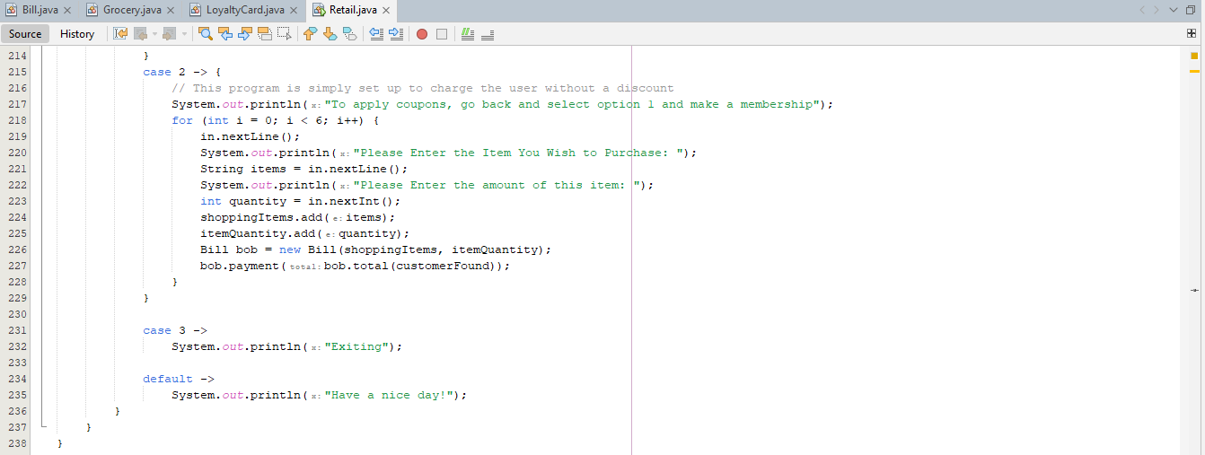
Notes:
This part of the code is where the previous cases have been skipped and is simply a setup to charge the user without a discount. A for loop setup to prompt the user for the items and quantity they want to purchase. After each item is added to the shopping cart, a new instance of the Bill class is created and the "payment" method is called with the total cost of the items purchased passed as an argument.
And then casel 3 just prints the message "Exiting" to indicate that the program is about to end.

Slide 31
Input Example

Slide 32
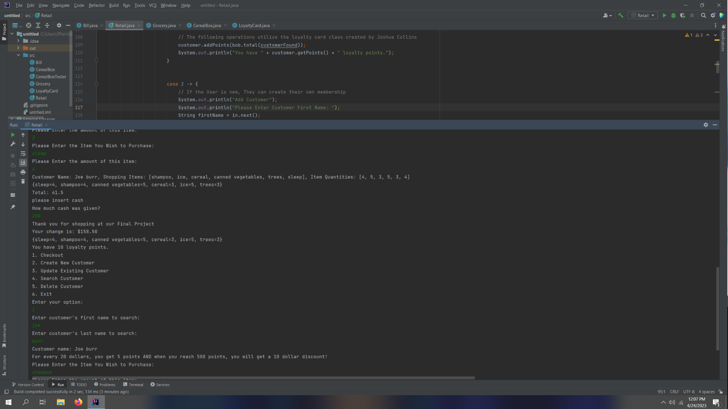

Slide 33
Questions?

